Slide 1

Store Sales ForecastinG
PRESENTED BY
Suyash
Vishal
Aarthy

Slide 2
Problem Statement :
i) A lack of predictive analysis / Not utilizing historical data.
ii) Lack of customer centric Stores / Time –Consuming.
iii) Absence of alert Mechanism of the Product.
iv) Seasonality.
v) No Tracking of expiry date of the product.

Slide 3
Existing Systems:
i) Stores not focusing on historical data for future sales prediction : Lack of technical usage in stores to predict the future sales using machine learning and deep learning concepts.
ii) Manual handling and time consuming : The costumer has to depend on the store employee in case he / she is not able to find the product, which leads to time wastage of customer and this is due to lack of technical use in stores backend.
iii) Absence of alert Mechanism of the Product : The biggest drawback in stores at current situation is they do not have alert generated in the case the stock clear.
iv) Not focused on seasonal products : Stores not utilizing the historical data to focus more on the seasonal products.

Slide 4
Gaps in Existing Systems:
i) A lack of predictive data /Not utilizing historical data: Generally stores don’t focus on predicting the sales using the historical data.
ii) Lack of customer centric stores : Customer have to depend on store employee to search the product.
iii) Absence of alert Mechanism of the Product : No alert messages generated when a product is likely to sell completely.
iv) Seasonality : Stores not focusing on seasonal products using historical sales data.
v) No Tracking of expiry date of the product : Customer have to check the expiry date of the product by themself which may leads to buy expiry product in hurry.

Slide 5
Problem Solution :
i) A lack of predictive data / Not utilizing historical data : By using Machine learning and deep learning concepts to predict the future values using the historical data.
ii) Lack of customer centric Stores / Time – Consuming : By searching a product on a machine, and it will display the location where it is placed.
iii) Absence of alert Mechanism of the Product : We can use python code to give us alert in case a product reaches a pre –defined minimum value.
iv) Seasonality : By using the predictive analysis concepts we can keep the more/ less products according to the seasons need.
ex: For summer we can purchase more ice-creams and in other seasons we can reduce the stocks.

Slide 6
Suggested Implementation method:
i) We can implement this method all the stores for easy access.
ii) This will increase the Customer delight and which will lead to customer repetition.
iii) This will reduce the head count of employees which will lead to more profit for stores.
iv) This will helps to avoid customer to consume the expired products.
v) On other hand, the stores will gain a good profit as CSI will be high.

Slide 7
Tools/ Technologies/Languages to be used :
i) Advance Python
ii) Machine learning concepts
iii) DBMS concepts /SQL
iv) Excel
v) Tableau
vi) Power BI

Slide 8
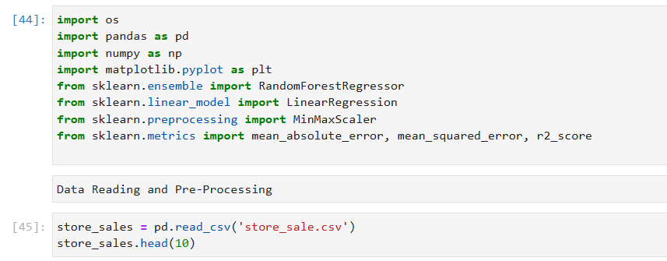
Project: Practical Demonstration
We used these Libraries and algorithms to build the model

Slide 9
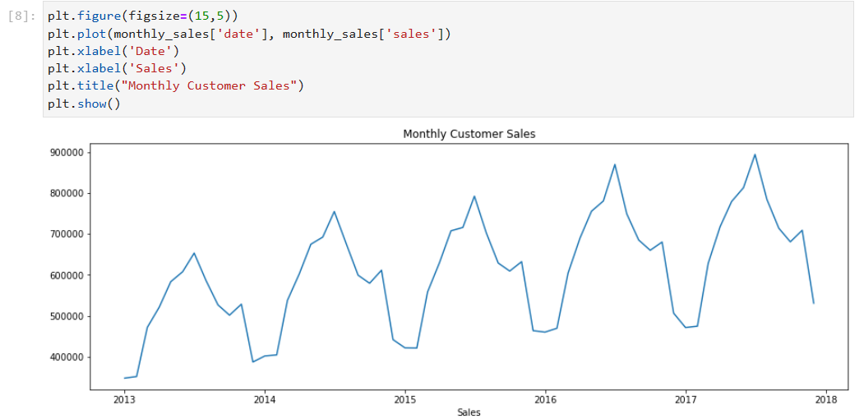
Practical Demonstration
Plot the Monthly Customer Sales

Slide 10
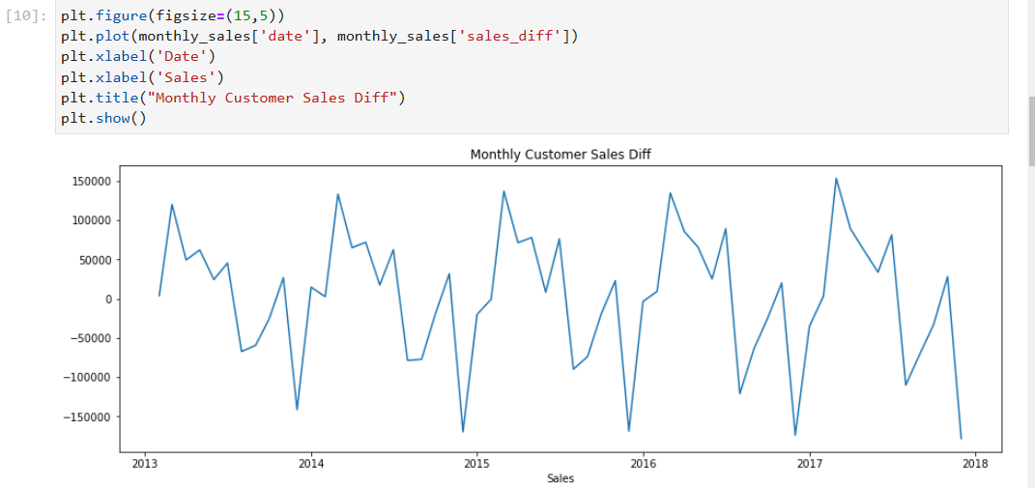
Practical Demonstration
Plot the Monthly Customer Sales Diff

Slide 11
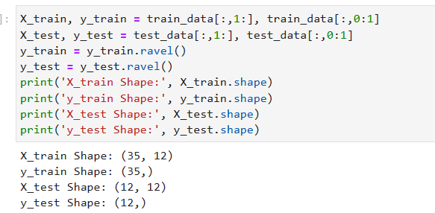
Practical Demonstration
Train_test data testing

Slide 12
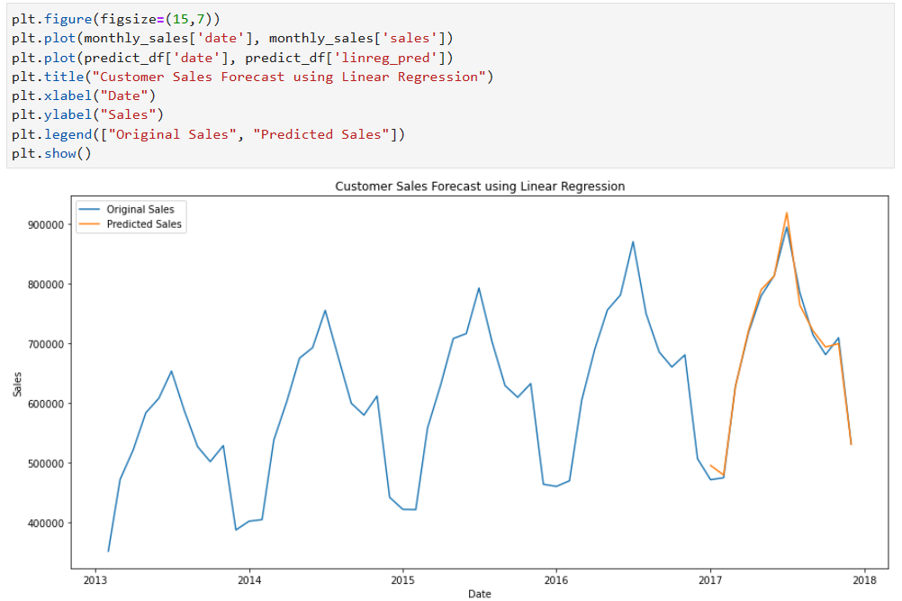
Practical Demonstration
Customer Sales forecast model using Linear Regression Algorithm

Slide 13
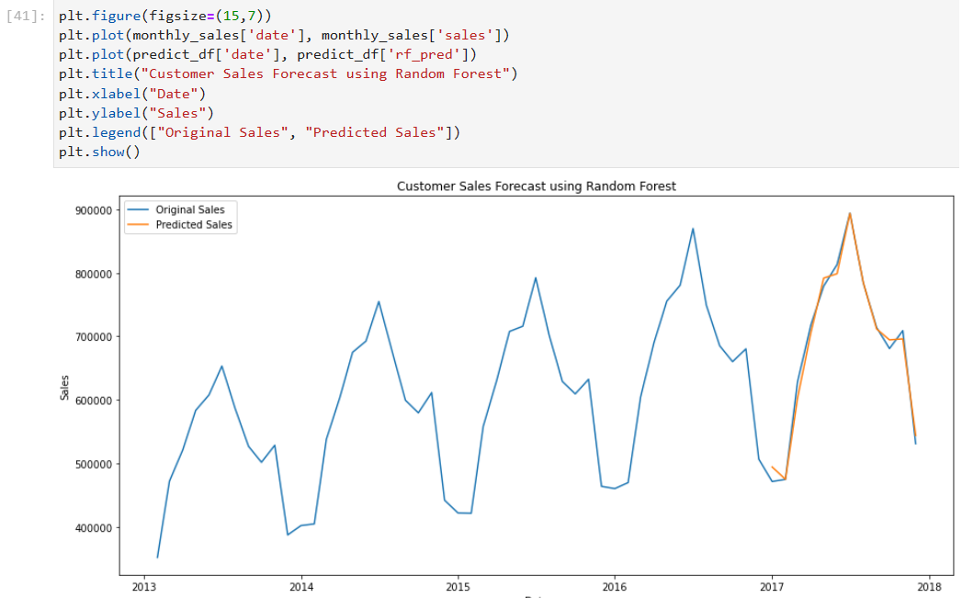
Practical Demonstration
Customer Sales forecast model using Random Forest Algorithm

Slide 14
Thank you !!

